Slide 1

Enhancing Clinical Trials FDA Submission Documentation through the Power of Metadata
A Proposal for New Standards in Open-Source Submissions
FDA Quarterly Meeting : 16OCT2024
Presented by the PHUSE Open-Source Metadata Documentation Working Group (OSDocuMetaWG)

Slide 2




PHUSE Open-Source Metadata Documentation Working Group (OSDocuMetaWG)
Lovemore
Gakava (Co-Lead Novo Nordisk)
Joel Laxamana
(Co-Lead - Roche/
Genentech)
Steven Haesendonckx
(Johnson and Johnson)
Nicholas Masel
(Johnson & Johnson)

Slide 3
Problem Statement & Objective
- The objective of this project is to develop a new template or enhance an existing one, such as the Study Data Standardization Plan (SDSP) or Analysis Data Reviewer’s Guide (ADRG).
- The aim is to ensure consistent documentation of metadata pertaining to the versions of statistical packages and procedures, aligning with health authority expectations.
- The standardized template will streamline the submission of clinical study metadata to health authorities as part of the regulatory review process.

Slide 4
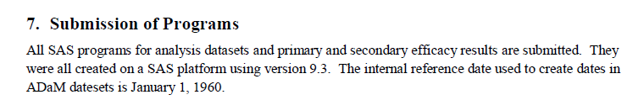
Documentation of versions of statistical packages and procedures
Proprietary Statistical Programming Languages
The version metadata of the statistical procedures/functions has been documented within the Statistical Analysis Plan with a general statement of software and version used (other companies may use other documentation)
Detailed information has been added to the Analysis Data Reviewer’s Guide (ADRG). The ADRG has a section where the programming software version and functions are specified
Notes:
Analysis Data Reviewer's Guide (ADRG) Package - WORKING GROUPS - PHUSE Advance Hub : ADRG_Example1_With_LDCP_20190718

Slide 5
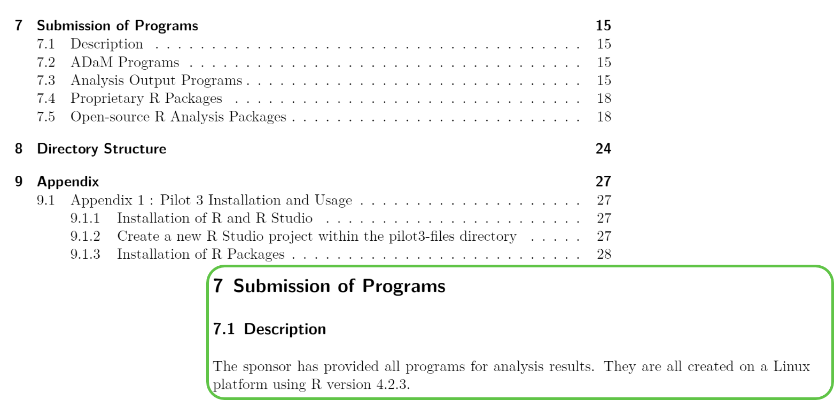
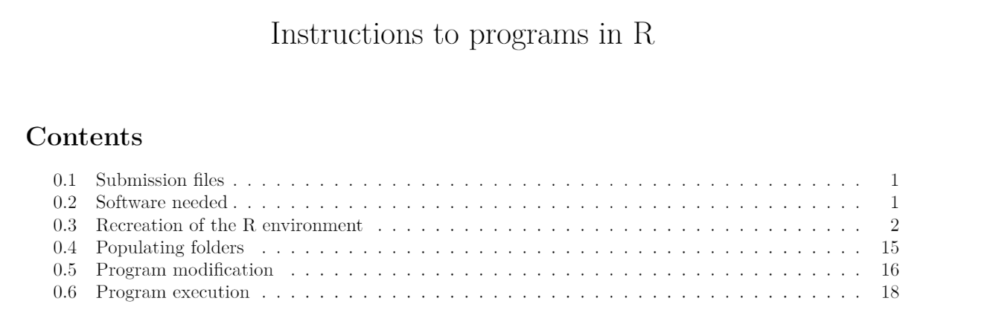
Documentation of versions of statistical packages and procedures
Open-Source software
Challenges
For the regulatory authority to reproduce the analysis, additional information is needed such as:
A summary of analysis packages, their versions and download locations
The software version and download location
Additional instructions for reproducibility of the computing environment.
Current R-based submissions
ADRG Example 1: R Submission Pilot 3 ADRG Example 2: Novo Nordisk R submission
Notes:
submissions-pilot3-adam-to-fda/m5/datasets/rconsortiumpilot3/analysis/adam/datasets/adrg.pdf at main · RConsortium/submissions-pilot3-adam-to-fda (github.com)
phuse-css-2023/submission-files/instructions-to-programs-in-r.pdf at main · NNaikp/phuse-css-2023 (github.com)
Description of existing ADRG template from Pinnacle 21
Importance of integrating open-source metadata

Slide 6
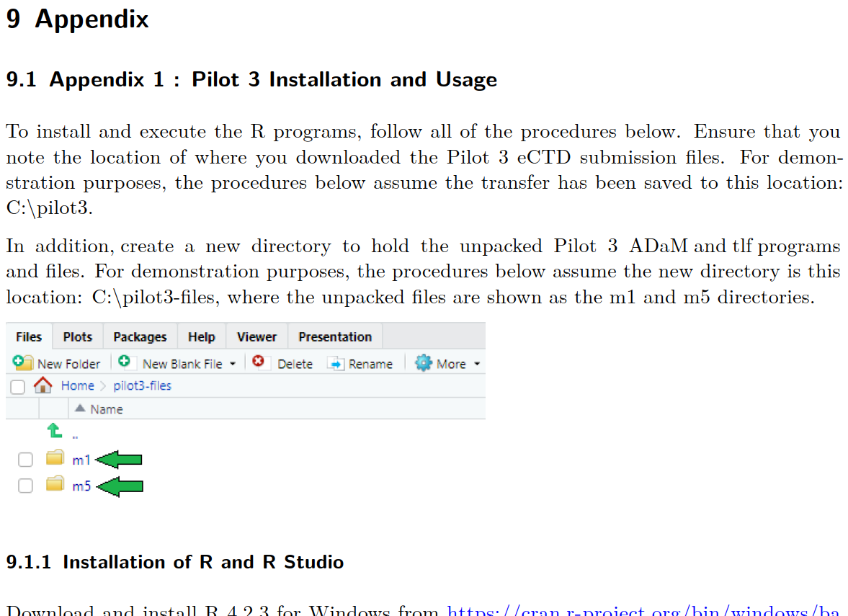
Instructions for Reproducing the Analysis Environment for HA review : Pilot 3 ADRG
Currently, in the Pilot 3 ADRG, we have a section, which covers detailed step-by-step instructions on how to set-up the analysis environment and re-execute the analysis scripts.
Our proposal is to allow the addition of a section like this in the ADRG.
An example demo can be found here :
R Consortium's R-based Test Submission Package for FDA Evaluation - Joel Laxamana

Slide 7
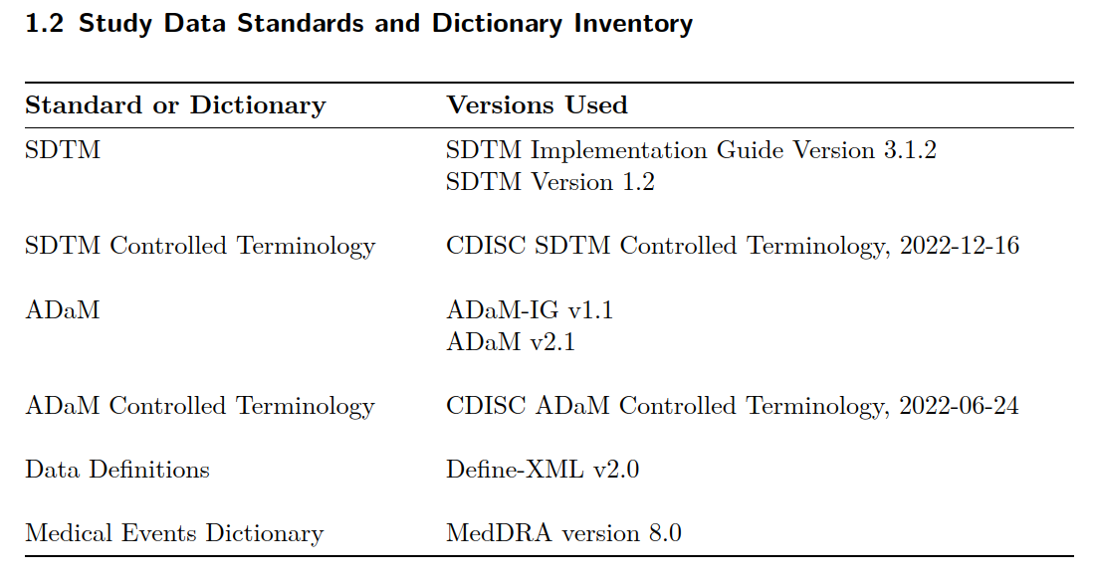
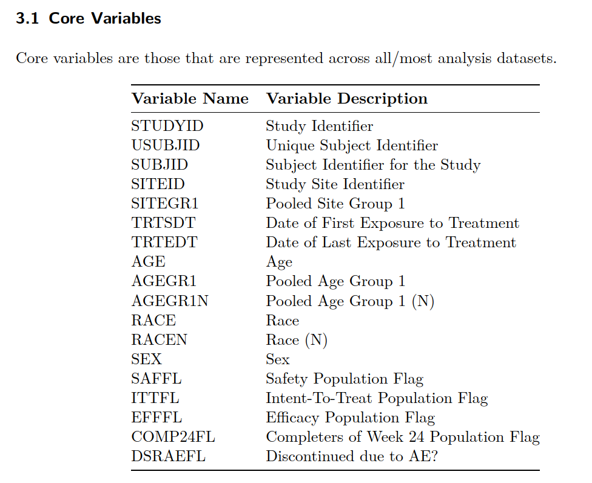
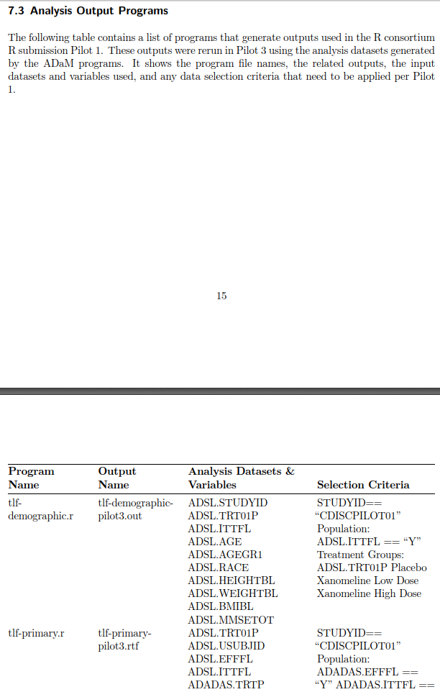
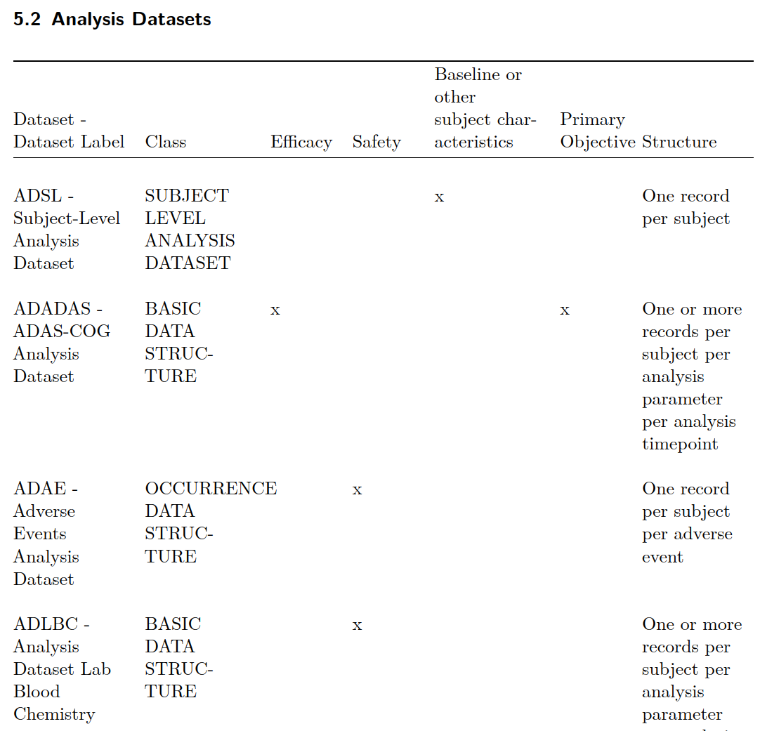
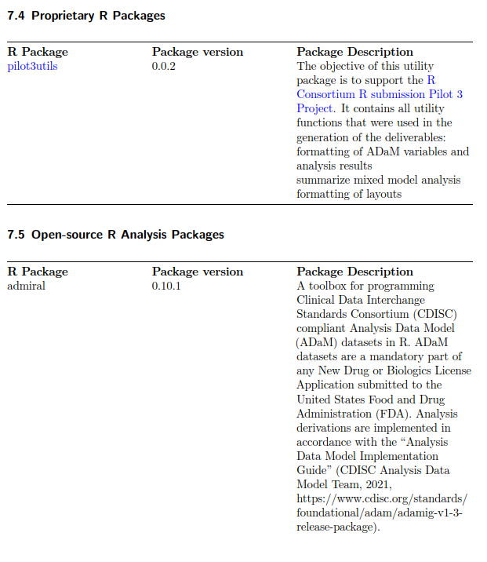
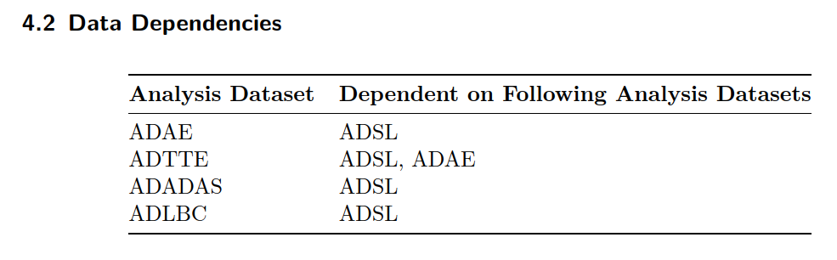
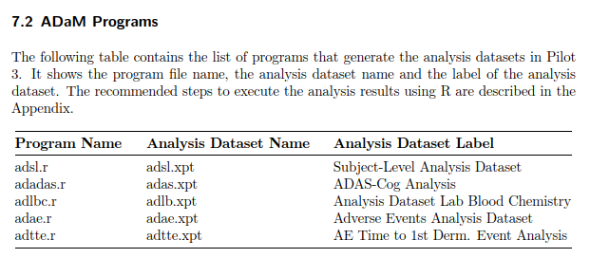
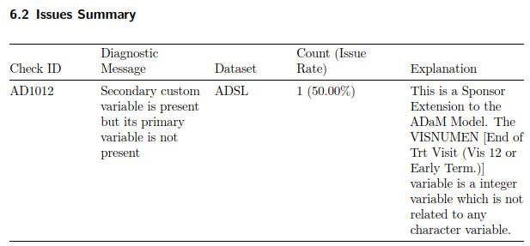
Other Metadata use Opportunities
Tables in the Current ADRG for Automation - from the Pilot 3 ADRG
1.2 Study Data Standards and Dictionary Inventory
Potential source: TS SDTM metadata
3.1 Core Variables
Source: define.xml specifications
4.2 Data Dependencies
Code scraping for ADaM programs.
5.2 Analysis Datasets
Metadata extraction from .xpts
6.2 Issues Summary
Report extraction from Pinnacle 21
7.2 ADaM Programs
Metadata extraction from .xpts
7.3 Analysis Output Programs
Read in folder that contains selected outputs
7.4 & 7.5 R Packages
Code utilizing SessionInfo() and {renv}

Slide 8
Other eCTD Structure and File Format Opportunities
Enhancing FDA Submissions with HTML and QMD Files
Introduction
Current State: Submissions include ADRG as .pdf files
Proposal: Include .html and .qmd files in submissions
Benefits of HTML and QMD Files
1. Reproducibility
Dynamic content and up-to-date rendering
Easier to replicate and verify analyses
2. Enhanced Documentation
Rich features like hyperlinks, tables, and multimedia
Improved user experience and readability
3. Versatility
HTML Files: Interactive, easily navigable, and portable
QMD Files: Can be rendered to both HTML and PDF formats for flexibility
4. Immediate Advantages
Modern, dynamic presentations of data and metadata
Facilitate better understanding and review processes
Ability to quickly convert back to traditional PDF if necessary
5. Conclusion
Proposal for FDA and Health Agencies to accept .html and .qmd files
Enhances data reproducibility, documentation, and overall submission quality

Slide 9
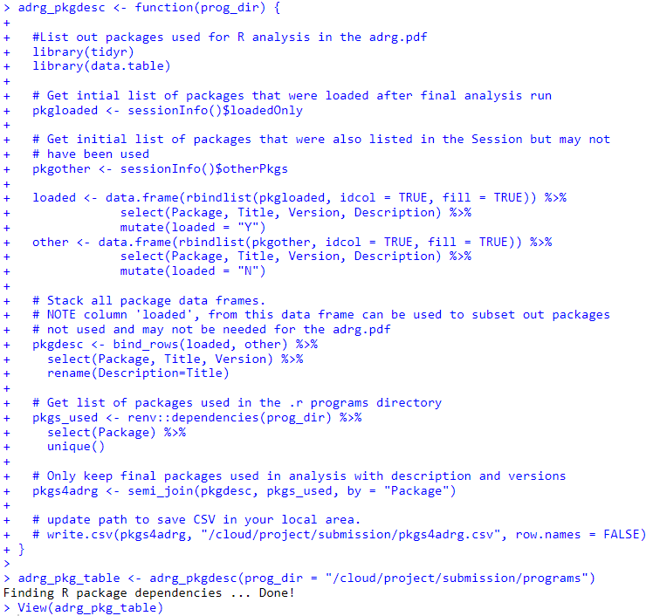
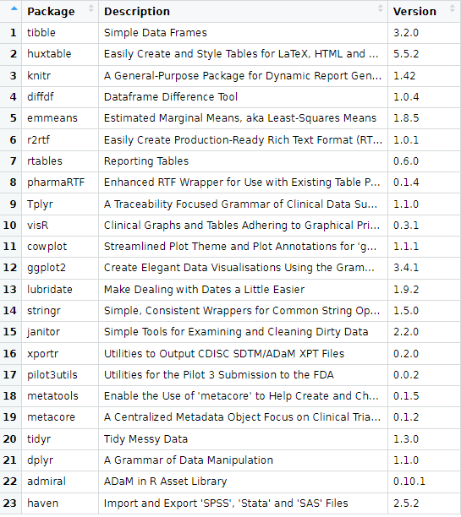
Open-Source Package Development
Possibility of an Open-Source Package
For example : A R function that can utilize metadata from the project R Environment to help semi-automate a list of R packages to include in the ADRG.
Code utilizing SessionInfo() and {renv}
Benefits for stakeholders
Provides necessary information needed for reproducibility
Standardization
Allows future Open-Source submissions to follow the same approach in a consistent and efficient manner
Looking ahead
From the list of “Other Metadata use Opportunities”, more functions like this can be developed and stored in an Open-source package to help collect further metadata to fill in the ADRG template. This can modernize the way we develop the ADRG today.
On the right you can see the function which collects the list of R packages used in a Clinical Trial Analysis, the actual list of R packages, Description and Version, then how this information is brought into the ADRG.

Slide 10
Possible solutions
Open Source submissions
Add the information to the SAP and ADRG
Add the information to the ADRG - similar to the example submissions
Create a supplementary document to ADRG with the open source information
Other?
Hybrid Submissions
Add the information to the SAP and ADRG?
Notes:
the versions of statistical packages and procedures

Slide 11
Next Steps and Feedback
Review and Feedback :
Current notes and brainstorming : OSDocuMeta Minutes
Call for Input :
Encourage thoughts and suggestions offline (add a question here).

Slide 12
The End : THANK YOU FOR YOUR TIME!
Q&A

Slide 13
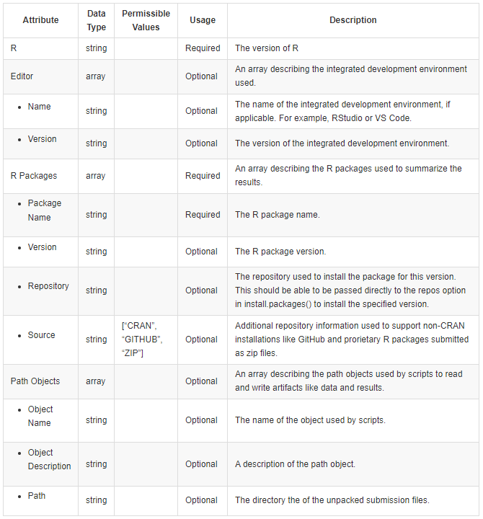
A Draft Proposal of Environment Metadata Specifications
Purpose
Standardize the environment metadata to provide a consistent structure on which additional tooling can be built, allowing regulatory reviewers to unpack and reproduce the R environment.
To clearly define what sponsors should provide to allow reproduction of the R environment.
Proposal
Additional file included in the submission
Format: JSON
R Package to be built to support the creation and use of this file to recreate the environment
Notes:
As part of the sponsors system qualifications, R packages are selected, qualified and documentation is generated to show the set of packages produce the expected results.
How this is metadata is stored from sponsor to sponsor will differ, but a standardized structure in the ADRG will ensure regulatory agencies receive consistent environmental metadata that will allow you to recreate the programming environment.
Minimal required metadata currently vary, but consists of some combination of artifacts that provide you with the R and RStudio version, a list of R packages, the installation repository and snapshot date and/or package version, and if you want to execute the sponsors script, something to configure the path objects to address the difference between input and output directories between the sponsor and regulatory agency.

Slide 14
Other Metadata use Opportunities
Tables in the Current ADRG for Automation - from the Pilot 3 ADRG
1.2 Study Data Standards and Dictionary Inventory
Potential source: TS SDTM metadata
3.1 Core Variables
Source: define.xml specifications or ADVARDEF created during submission process
4.2 Data Dependencies
Code scraping for ADaM programs. Agree
5.2 Analysis Datasets
Metadata extraction from .xpts or ADVALDEF
6.2 Issues Summary
Report extraction from Pinnacle 21 Agree
7.2 ADaM Programs
Metadata extraction from .xpts => code scraping to understand dependencies
7.3 Analysis Output Programs
Complexity of selection criteria => read in folder that contains selected outputs
7.4 Proprietary R Packages
Code utilizing SessionInfo() and {renv} yes

